Slide 1
Research Topics
- Sourabh S Shenoy

Slide 2
Table of Contents
Levenshtein Distance
Boyer Moore Horsepool String matching Algorithm
Radix Exchange Sort
Introsort
Randomized Quicksort
Spatial DBMS

Slide 3
Levenshtein Distance
Boyer Moore Horsepool String matching Algorithm
Radix Exchange Sort
Introsort
Randomized Quicksort
Spatial DBMS

Slide 4

Levenshtein Distance
A string metric for measuring the difference between two sequences
In other words, the Levenshtein distance between two words is the minimum number of single-character edits (i.e. insertions, deletions or substitutions) required to change one word into the other.

Slide 5
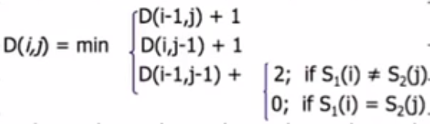
How to calculate Levenshtein Distance?
1
6
5
4
4
4
5
Edit distance
E | 7
T | 6
I | 5
M | 4
A | 3
M | 2
N | 1
# | 0 | 1 | 2 | 3 | 4 | 5 | 6
 | # | N | I | T | T | E | T
5
4
3
4
5
4
4
3
4
4
4
5
3
3
3
3
4
5
2
2
2
3
4
5
1
1
2
3
4
5
0
1
2
3
4
5

Slide 6
Uses
Redisplay algorithms for video editors
Study of bird songs
Speech recognition
Comparing genetic sequences
Virus Scanners
Security Kernels
Spell Checkers
Optical Character Recognition
Also to detect co-related attacks in Distributed Systems

Slide 7
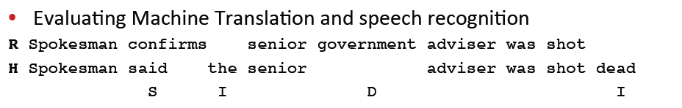
Use of Edit Distance in NLP
©Stanford NLP

Slide 8
Potential Bottleneck?
Huge Amount of memory needed when the words to be compared with are large!
If we use a dictionary of words, upper bound for the runtime is O( <number of words> * <max word length> ^2 )

Slide 9
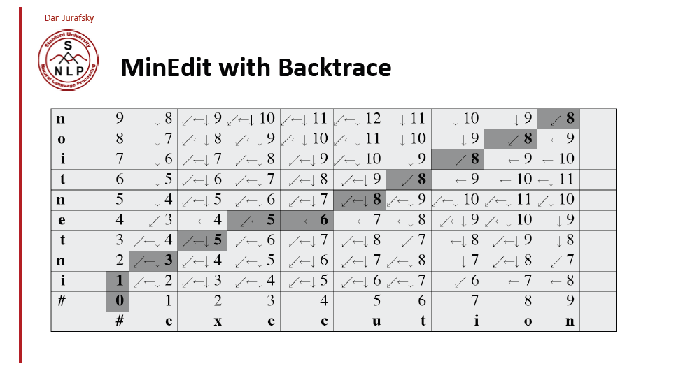
Alternative approach → Backtrack!
©Stanford NLP

Slide 10
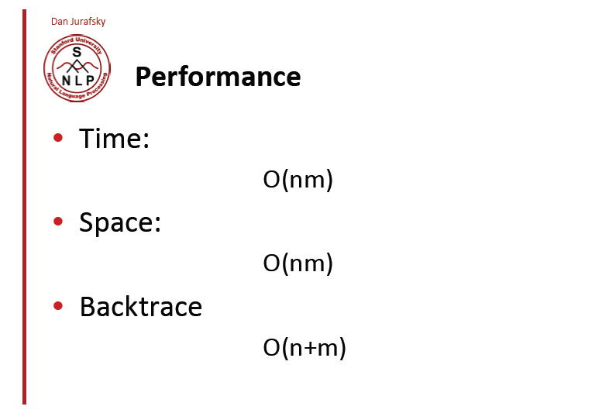
©Stanford NLP

Slide 11
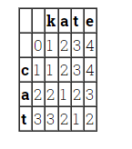
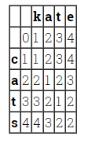
Can we do still better?
Src: http://stevehanov.ca/blog/index.php?id=114

Slide 12
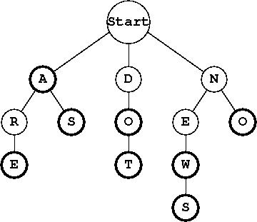
Use Tries!

Slide 13
This website has an implementation of both the regular method and using tries in Python. The findings are astounding!
The second algorithm is over 300 times faster than the first.
We create at most one row of the table for each node in the trie
The upper bound for the runtime is O(<max word length> * <number of nodes in the trie>)

Slide 14
Levenshtein Distance in Postgres
Levenshtein.c source file in postgres

Slide 15
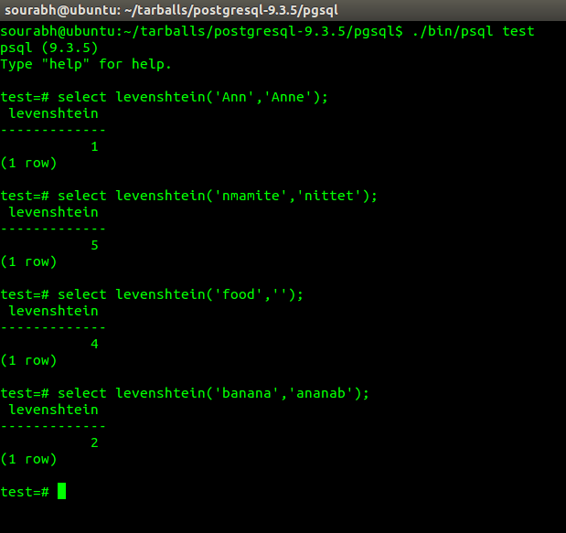

Slide 16
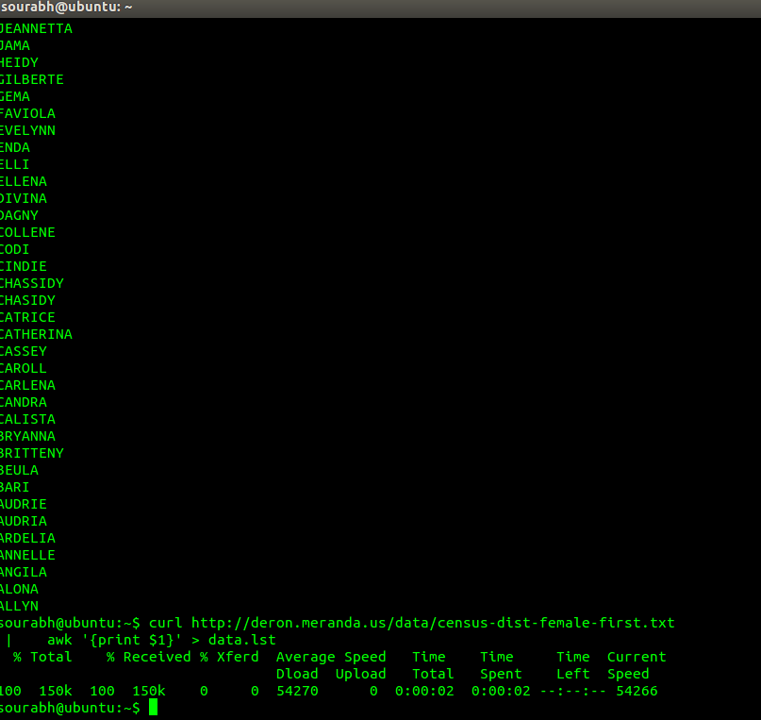
Link to Data.lst

Slide 17
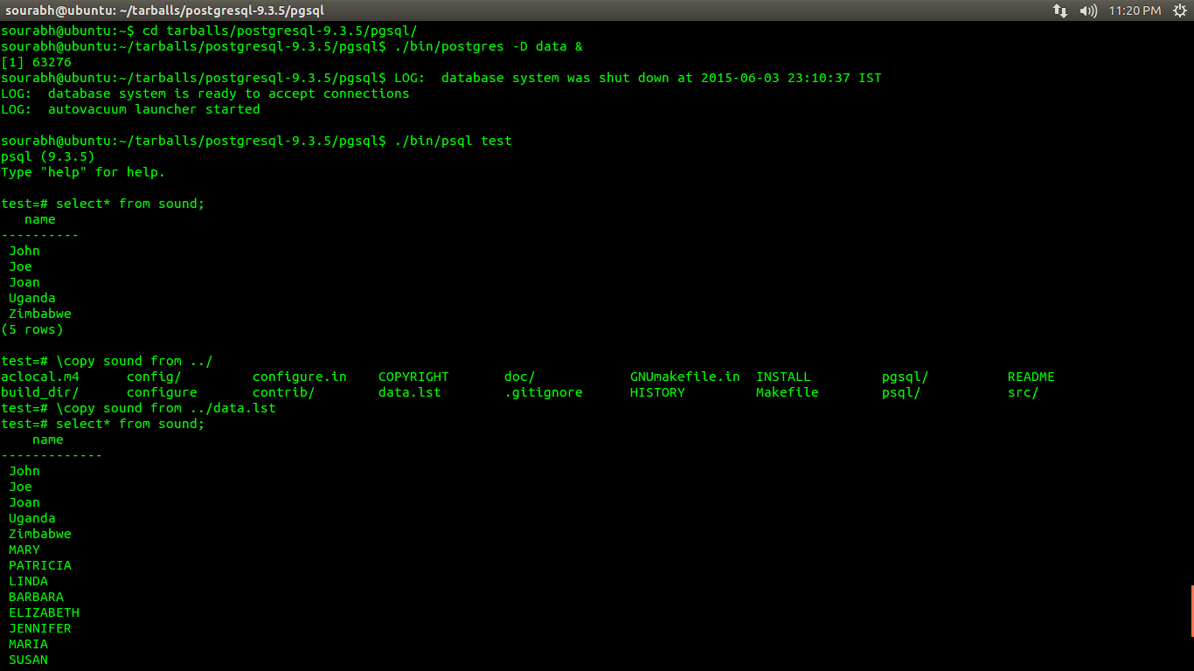

Slide 18
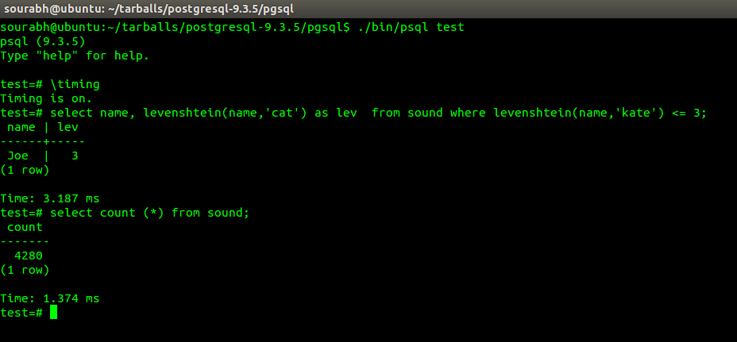

Slide 19
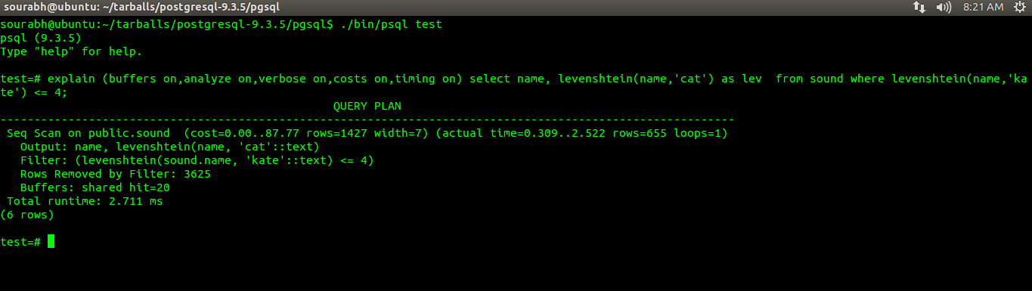

Slide 20
Soundex
Hashing system for English words
Phonetic algorithm
From an English word, we generate a letter and three numbers which roughly describe how an given word sounds
Similar sounding words will have similar codes
The downside is that there is no support for characters beyond the 26 letters used in the English language.

Slide 21
The first letter is simply the first letter in the word. The remaining numbers range from 1 to 6, indicating different categories of sounds created by consonants following the first letter. If the word is too short to generate 3 numbers, 0 is added as needed. If the generated code is longer than 3 numbers, the extra are thrown away.
Code | Letters
1 | B, F, P, V
2 | C, G, J, K, Q, S, X, Z
3 | D, T
4 | L
5 | M, N
6 | R
SKIP | A, E, I, O, U, H, W, Y

Slide 22
Sample Soundex codes
Word | Soundex
Washington | W252
Wu | W000
DeSmet | D253
Gutierrez | G362
Pfister | P236
Jackson | J250
Tymczak | T522
Ashcraft | A261

Slide 23
Difference
The DIFFERENCE function compares the SOUNDEX values of two strings and evaluates the similarity between them, returning a value from 0 through 4, where 4 is the best match.

Slide 24
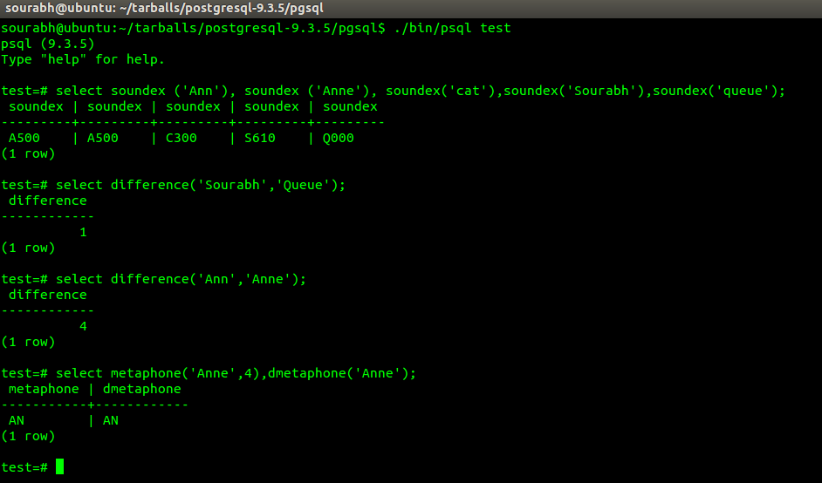

Slide 25
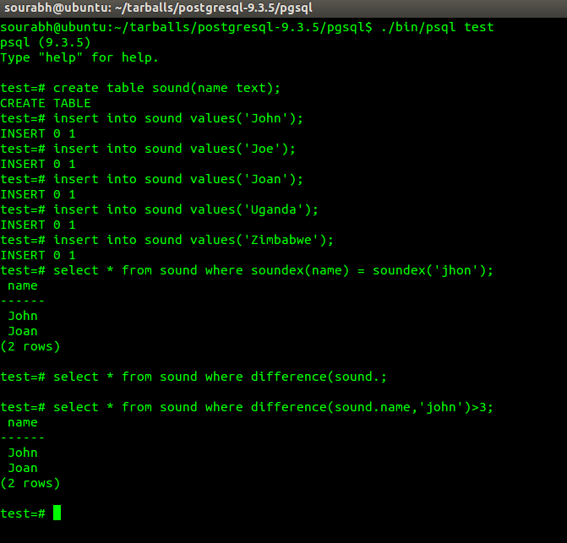

Slide 26
This slide is intentionally left blank

Slide 27
Levenshtein Distance
Boyer Moore Horsepool String matching Algorithm
Radix Exchange Sort
Introsort
Randomized Quicksort
Spatial DBMS

Slide 28
Boyer-Moore-Horsepool String Matching
It is useful when pattern is shorter than the String
Has a lower constant factor than many other string algorithms
A brute-force search of all alignments takes m-n+1 steps, whereas Boyer-Moore uses information gained by preprocessing the pattern to skip as many alignments as possible.
Time complexity of O(m+n)
Notes:
The Boyer-Moore algorithm uses information gathered during the preprocess step to skip sections of the text, resulting in a lower constant factor than many other string algorithms.
Naïve string matching has worst case scenario of O(NM). For instance, When text is aaaa…b and pattern is aa..b.
Boyer Moore also has worst case of O(MN). For instance, searching 01..1 in 1^n.
Best case: searching 0^m in 1^n. O(M/N)
Average Case: O(M/|E|)

Slide 29
Steps
Create a “Bad Match table” for all the letters.
Value of a letter present in the pattern = length of the pattern – index – 1
For every other letter, value = length
No letter is repeated in the table
Also, last letter of the pattern = length

Slide 30
Sample Bad Match Table
Pattern = nittenmamit
Length = 11
n i t t e n m a m i t
0 1 2 3 4 5 6 7 8 9 10
BMT
N | I | T | E | M | A | *
Value
7
1
11
3
11
10
9
6
5
8
2
4
Value = 11 - Index - 1

Slide 31
Example
N | I | T | E | M | A | *
5 | 1 | 11 | 6 | 2 | 3 | 11
Hello world i am from nmamit nmite
also knoan as nittenmamit and am …
nittenmamit

Slide 32
Example
N | I | T | E | M | A | *
5 | 1 | 11 | 6 | 2 | 3 | 11
Hello world i am from nmamit nmite
also knoan as nittenmamit and am …
nittenmamit

Slide 33
Example
N | I | T | E | M | A | *
5 | 1 | 11 | 6 | 2 | 3 | 11
Hello world i am from nmamit nmite
also knoan as nittenmamit and am …
ni
ttenmamit

Slide 34
Example
N | I | T | E | M | A | *
5 | 1 | 11 | 6 | 2 | 3 | 11
Hello world i am from nmamit nmite
also knoan as nittenmamit and am …
nittenmamit

Slide 35
Example
N | I | T | E | M | A | *
5 | 1 | 11 | 6 | 2 | 3 | 11
Hello world i am from nmamit nmite
also knoan as nittenmamit and am …
nittenmamit

Slide 36
Example
N | I | T | E | M | A | *
5 | 1 | 11 | 6 | 2 | 3 | 11
Hello world i am from nmamit nmite
also knoan as nittenmamit and am …
nittenmamit
Match Found!!

Slide 37
Applications
Web Searches
Detecting Plagiarism
Database Queries
Lexical analysis
Bio Informatics
Text Editing

Slide 38
Levenshtein Distance
Boyer Moore Horsepool String matching Algorithm
Radix Exchange Sort
Introsort
Randomized Quicksort
Spatial DBMS

Slide 39
Radix Exchange Sort
An integer sorting algorithm that considers the “structure” of the keys
Keys are represented using base M. For instance, if M = 2, it is binary, and 4 would be represented as 100, 7 as 111 etc.
Sorting is done by comparing bits in the same position. Consider numbers 3 and 2. 3 is 11 and 2 is 10. By comparing RMD, (0<1), we can conclude that 2 comes before 3

Slide 40
Example
Sort numbers: 5, 8, 16, 33, 37, 3, 14, 7, 2, 55
0 | 0 | 0 | 1 | 0 | 1
0 | 0 | 1 | 0 | 0 | 0
0 | 0 | 0 | 0 | 1 | 1
0 | 0 | 1 | 1 | 1 | 0
0 | 0 | 0 | 1 | 1 | 1
0 | 0 | 0 | 0 | 1 | 0
0 | 0 | 0 | 1 | 0 | 1
0 | 0 | 1 | 0 | 0 | 0
0 | 1 | 0 | 0 | 0 | 0
0 | 0 | 0 | 0 | 1 | 1
0 | 0 | 1 | 1 | 1 | 0
0 | 0 | 0 | 1 | 1 | 1
0 | 0 | 0 | 0 | 1 | 0
2 | 000010
3 | 000011
5 | 000101
7 | 000111
8 | 001000
14 | 001110
16 | 001110
33 | 100001
37 | 100101
55 | 110111
5 | 000101
8 | 001000
16 | 010000
33 | 100001
37 | 100101
3 | 000011
14 | 001110
7 | 000111
2 | 000010
55 | 110111
. . .
0 | 1 | 0 | 0 | 0 | 0
1 | 0 | 0 | 0 | 0 | 1
1 | 0 | 0 | 1 | 0 | 1
1 | 0 | 0 | 0 | 0 | 1
1 | 0 | 0 | 1 | 0 | 1
1 | 1 | 0 | 1 | 1 | 1
1 | 1 | 0 | 1 | 1 | 1

Slide 41
Some Observations…
As we can see, the algorithm can be implemented using recursion
Also, the partitioning can be done using the same logic used to implement quicksort
Time to sort n b-bit numbers would be O(bn).
i.e.; T(n, b) = T(i, b-1) + T(n-i,b-1) + n which will hold true when T(n, b)=bn

Slide 42
How partitioning works!
Pseudo code:
Do
Scan from top till you encounter key starting with 1 (using i)
Scan from bottom till you encounter key starting with 0 (using j)
Exchange keys
Until i > j
1
1
0
1
1
0
0
1
0
1
1
1
0
0
1
1
1
1
i > j, so stop and split

Slide 43
Levenshtein Distance
Boyer Moore Horsepool String matching Algorithm
Radix Exchange Sort
Introsort
Randomized Quicksort
Spatial DBMS

Slide 44
Introsort
Also called as Introspective sort
A hybrid sorting algorithm that provides fast average case scenario and relatively better worst case scenario.
It begins with quicksort and switches to heap sort when the recursion depth exceeds 2* log(N)₂, due to selection of bad pivot.

Slide 45
Pseudo code
Source: Wikipedia
procedure sort(A : array):
let maxdepth = ⌊log(length(A))⌋ × 2
introsort(A, maxdepth)
procedure introsort(A, maxdepth):
n ← length(A)
if n ≤ 1:
return // base case
else if maxdepth = 0:
heapsort(A)
else:
p ← partition(A, p) // assume this function does pivot selection
introsort(A[0:p], maxdepth - 1) introsort(A[p+1:n], maxdepth - 1)

Slide 46
Example for Introsort
http://www.xiaotu.com/sdba/action/a9over1/introSort.swf

Slide 47
Proposal
Introsort can be implemented on CUDA by using quick sort for most cases, heap sort when recursion depth exceeds 2*logN and using insertion sort when the number of elements is small.
The idea behind this is that heap sort is guaranteed to run in O(N*logN) time and Insertion sort is faster for small number of elements.
All these techniques sort in place.

Slide 48
Levenshtein Distance
Boyer Moore Horsepool String matching Algorithm
Radix Exchange Sort
Introsort
Randomized Quicksort
Spatial DBMS

Slide 49
Implementing randomized quicksort
Running time of Quicksort depends on the distribution of splits
Best case: T(N)=2*T(N/2)+Ɵ(N)
Worst case: T(N)=T(1)+T(N-1)+Ɵ(N) = Ɵ(N²) (Usually when the input array is reverse sorted)
In general, we would want the array to be split in half each time (Ideal case). This would require us to choose the median element for each sub array. (caveat?)

Slide 50
Randomized quicksort only tries to ameliorate the worst case behavior. That is not to say that worst case behaviors do not occur!
For example: Consider a descending sequence; Supposing the regular quicksort algorithm splits each subarray into 2 subarrays such that one of them has only one element and the other has the remaining, it would result in O(N2) complexity.
On the other hand, if Randomized quicksort were used, each subarray would be split in different proportions, depending on the number generated. (We should be extremely unlucky to get the same result as above!)

Slide 51
Pseudocode for Randomized Partition
Randomized-Partition (A, p, r)
i = Random(p, r)
Exchange A[r] with A[i]
return Partition(A, p, r)
Pseudocode for Randomized Quicksort
if (p < r)
q = Randomized-Partition(A, p, r)
Randomized-Quicksort(A, p, q-1)
Randomized-Quicksort(A, q+1, r)

Slide 52
Levenshtein Distance
Boyer Moore Horsepool String matching Algorithm
Radix Exchange Sort
Introsort
Randomized Quicksort
Spatial DBMS

Slide 53
Speeding up spatial database query execution using GPUs Bogdan Simion, Suprio Ray, Angela Demke Brown
Spatial Databases are useful for applications such as land surveying, urban planning etc.
Used to find answers to queries ranging from “Find the nearest hotel near my home” or “Find the number of malls in a 5km radius” to “Find the areas likely to be affected by the flood” etc.

Slide 54
Query execution is a 2 step process
Filtering shapes based on Minimum bounding rectangles (To reduce number of comparis0ns)
Refining candidate set by comparing actual geometries
The above two steps involve intensive computation, thus invoking the need to use massively parallel processing.
Scope: Spatial database workloads have not been studied in depth thus far and there has been no research on identifying the underlying system issues leading to performance problems in spatial databases

Slide 55
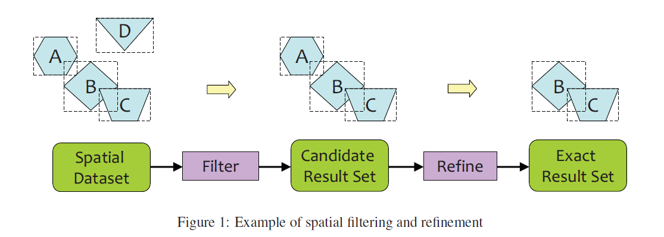
The 2-step process

Slide 56
Two types of Spatial Data: Raster and Vector
Raster
Has representations of various types of maps and are high-res images
Vector
Tries to capture represent everything geometrically such as using points for buildings, lines for rivers and roads, polygons for land mass and lakes etc.

Slide 57
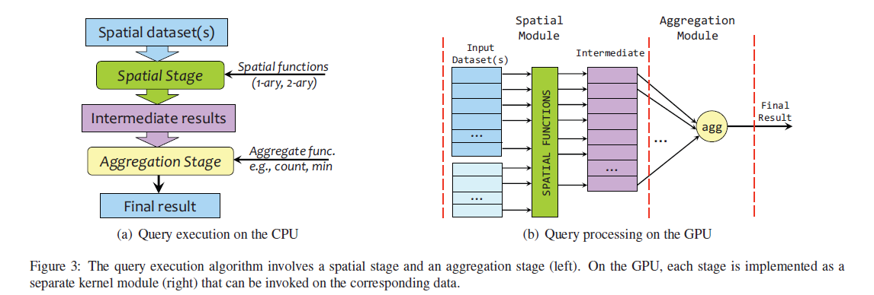
Operations involve checking if a point is within a given polygon (building in an area) or if a line intersects another line (river crossing a road) etc.

Slide 58
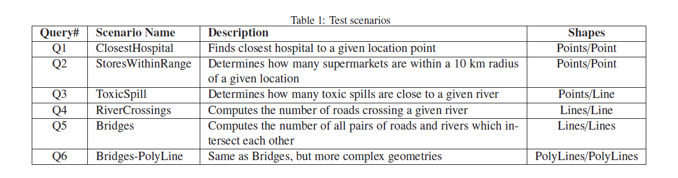

Slide 59
Conclusion and Future Work
Execution of geospatial queries can significantly benefit from processing on a GPU, because of their inherent high degree of parallelism.
Memory transfer cost is easily amortized by the query execution speedups.
Concurrent copy-execute feature could be used to potentially improve performance even further.
Analyze the benefit of processing multiple queries per GPU kernel
Notes:
Concurrent copy-execute feature provides the ability to overlap kernel execution and asynchronous data transfers
between host and device, thus alleviating some of the memory transfer overhead
Since both the spatial stage and the aggregation stage are performed in parallel on a large dataset and given
that the GPU threads basically process a fixed set of tuples from the relation, it may be possible to run multiple query
instances in parallel on the GPU. and what bottlenecks or restrictions we might encounter

Slide 60
Spare Slides

Slide 61
About CUDA (Basics)
Stands for Compute Unified Device Architecture
File has extension ‘.cu’
Use nvcc to compile .cu files nvcc –o runme kernel.cu
Use –c option to generate .obj files
nvcc –c kernel.cu g++ –c main.cpp g++ –o runme *.o

Slide 62
Sample Skeleton of CUDA Code
__global__ void abc(…){
…
[GPU (Parallel) code]
…
}
void main(){ …
[CPU (serial) code]
… abc<<<dimGrid, dimBlock>>>(…)
…
[CPU (serial) code]
…
}

Slide 63
CUDA Programming Model
Threads run in groups of 32 called “warps”
Each thread executes the same instruction but on different data
Kernel launches a grid of blocks
Threads and Blocks have unique ids that are available through special variables
All threads within a block can share data as well as synchronize
Host (CPU) and device (GPU) have separate memory spaces

Slide 64
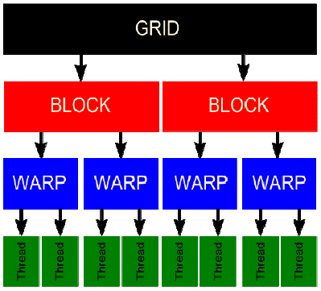
© NVIDIA Corporation

Slide 65
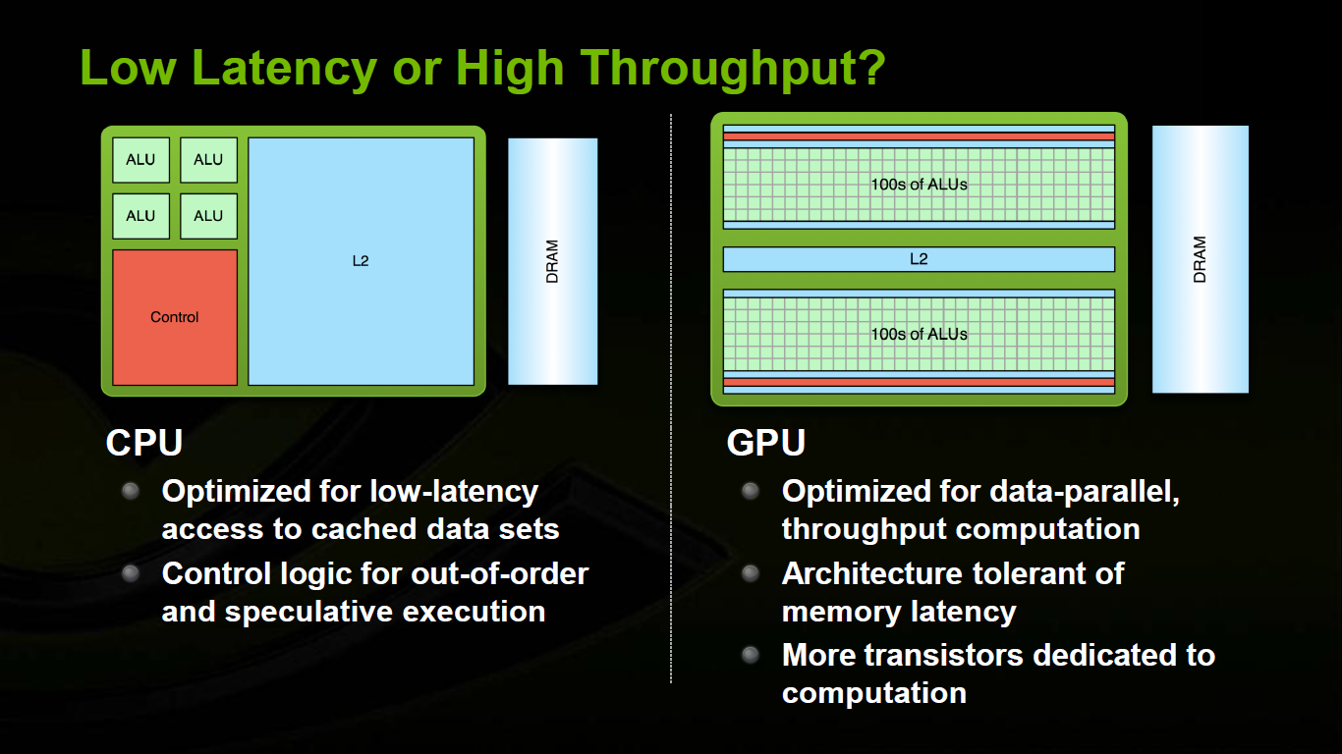
© NVIDIA Corporation
© NVIDIA Corporation

Slide 66
Thank You!

